Slide 1
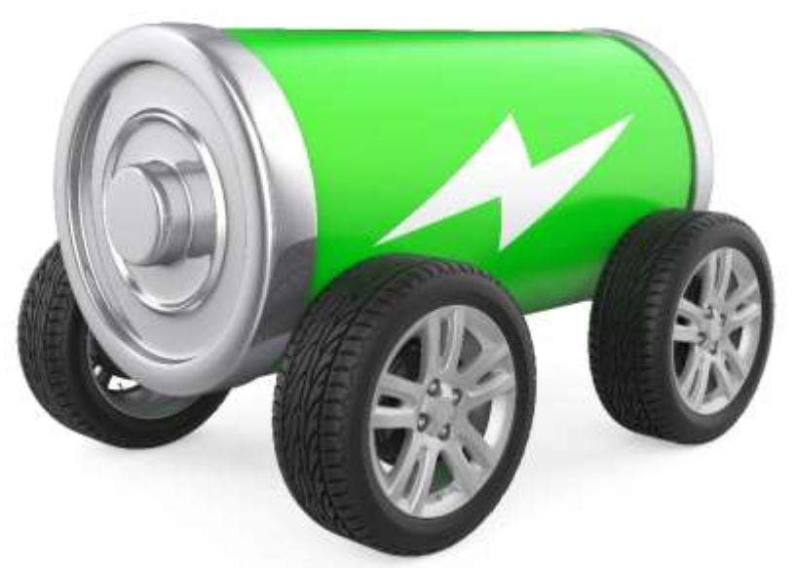
Gears Review

Slide 2
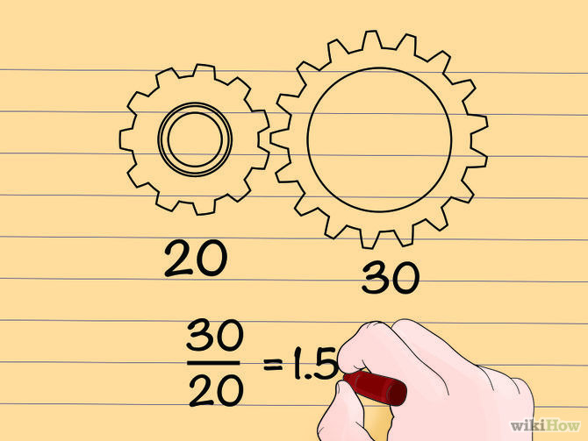
Finding Gear Ratios Divide one teeth count by the other
We can write this as 3/2 or 1.5 : 1
The smaller driver gear must turn one and a half times to get the larger driven gear to make one complete turn.
$$\frac{Driven Gear}{Driver Gear}=Gear Ratio$$
Driver Gear
Driven Gear

Slide 3
Geared for Torque or for Speed
Torque
Speed

Slide 4
Prototype
Building

Slide 5
What is a “Prototype”?
A first, typically a preliminary model of something, especially a machine, from which other forms are developed or copied.

Slide 6
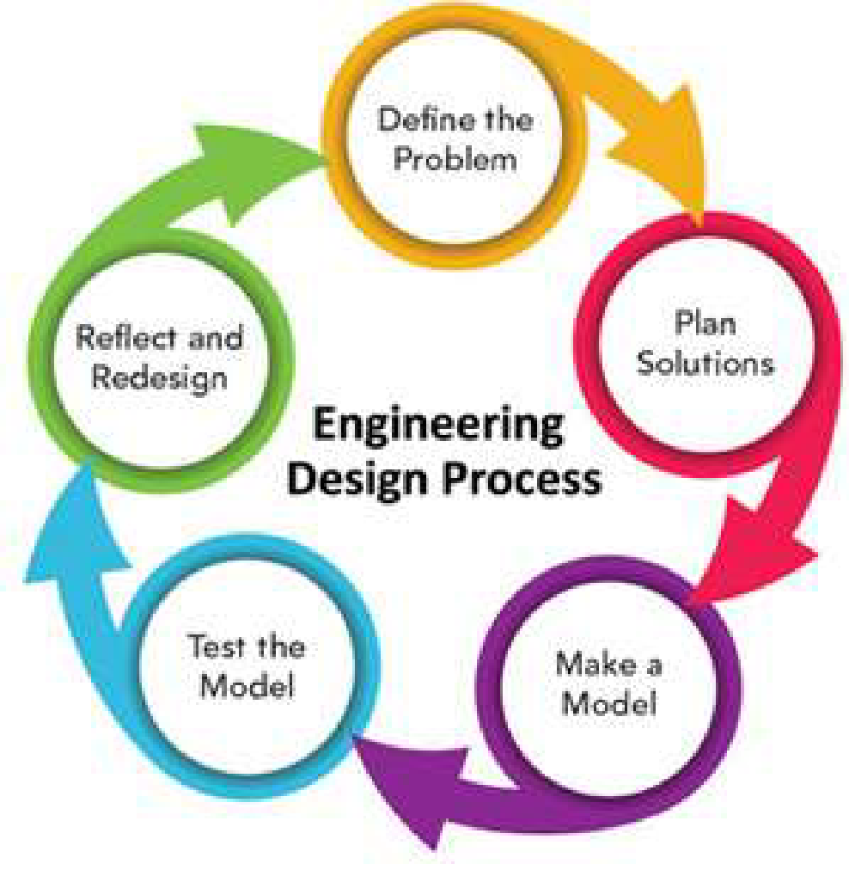
Use the Engineering Design Process to create your prototype

Slide 7
Define the Problem
Design and build an electric battery powered vehicle to travel a 20 meter (66 feet) long track the fastest.
Must use battery pack and motor provided by goHunterdon.
Must carry one empty 12 oz soda can with tab which can easily be removed from the vehicle.
Must attach to a guideline that runs the length of the track and must be easily attached and removed.
Max size is 12” wide, 24”long, 12” high.

Slide 8
Plan Solutions
Use what you have learned
Engineering design process
Battery power
Aerodynamics
Gears and gear ratios
Use the EV Challenge Engineering Design Progress Journal to document your process

Slide 9
Goals for This Lesson
Come up with a plan on how you are going to build your prototype
Build your prototype
Test it!
Rework anything that didn’t work correctly or the way you thought it would.
Write/draw what happened
Use the following supplies provided in your kit:
Motor Gear
Axle Gear
Axles (2)
Motor
Wheels (4)
Battery compartment
Add these from lesson box:
AA Batteries (2)
Tape
Chassis (Plastic Base)
Straws (1 – cut in half)

